Slide 1
Insurance Market in Republic of Macedonia in 2011

Slide 2
Insurance market Profile
15 Insurance undertakings (11 non-life; 4 life)
17 Insurance brokerage companies
6 Insurance agencies
Insurance penetration - GWP in % of GDP – 1,50% (2010:1,53%)
Insurance density - GWP per capita – 53,77 euro/capita (2010:51,24)

Slide 3
Gross Written Premium Ratios
Gross Written Premium :
2011: EUR 110.8 million (102.5 non life; 8.2 life)
2010: EUR 105.4 million ( 99.6 non life; 5.7 life)
↑ Gross Written Premium 11/ 10: (5.16%)
↑ Non life premium 11/ 10: (2.98%)
↑ Life premium 11/ 10: (42.76%)

Slide 4
GWP Comparison 2011/2010 by lines of business

Slide 5
Capital Adequacy and Solvency Margin

Slide 6
Financial result 2011
Financial result for 2011: EUR – 928.733
  Non-life insurance: EUR – 1.001.616
  Life insurance: EUR 72.883
Positive financial result
  Non-life insurance: 9 insurance undertakings
  Life insurance: 2 insurance undertakings
Negative financial result
  Non-life insurance: 2 insurance undertakings
  Life insurance: 2 insurance undertakings

Slide 7
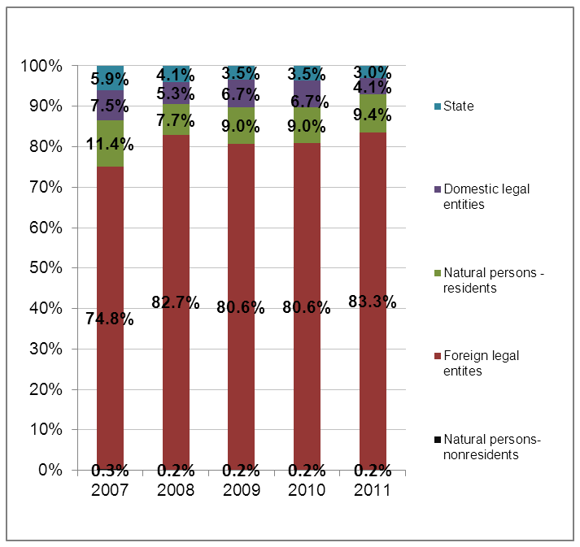
Insurance Market ownership structure

Slide 8
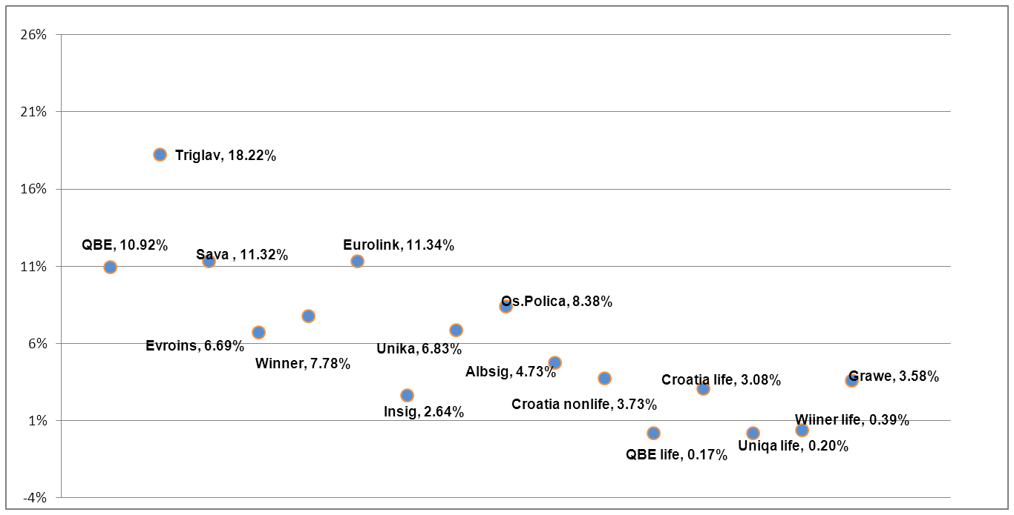
Market concentration 2011
4 insurance undertakings participate with more than 10%.

Slide 9
Technical reserves

Slide 10
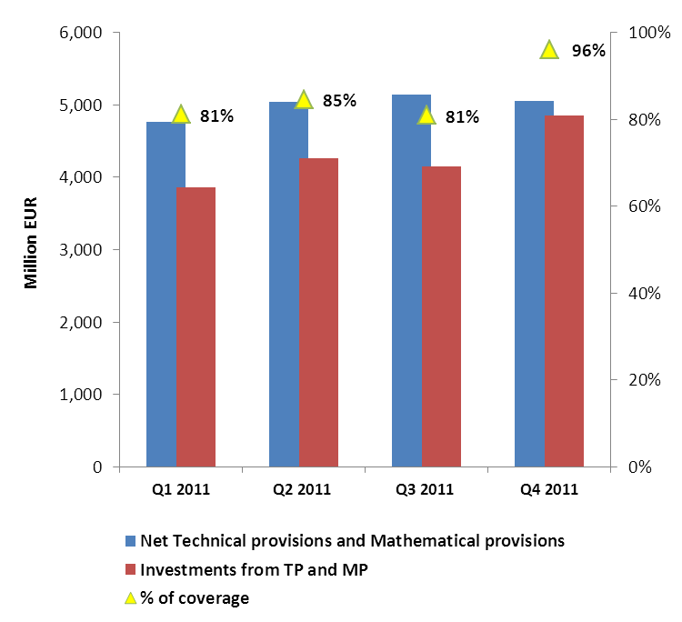
Technical provisions – non life
Trend | Investments covering Technical provisions

Slide 11
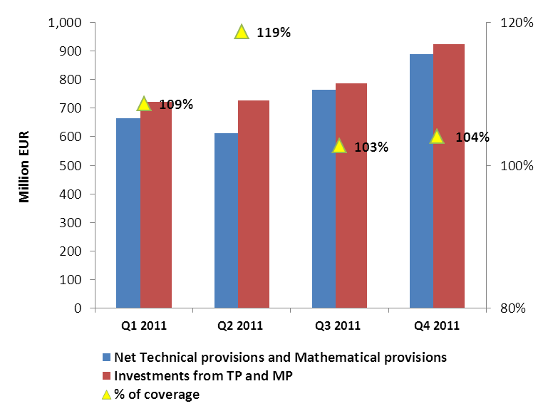
Technical and Mathematical provisions –life
Trend | Investments covering Technical and Mathematical provisions

Slide 12
Intermediation and Technical Coefficients
Distribution channels | % of GWP
Direct sales | 45,69%
Insurance brokerage companies | 20,71%
Tourists agencies | 0,52%
Banks | 1,00%
Insurance agencies | 4,55%
Car dealers stores | 0,44%
Insurance agents- natural persons | 23,12%
Other distribution channels | 3,97%
Total | 100,00%
Technical coefficients | 2011 | 2010
Claims ratio | 57.45% | 62.59%
Expenses ratio | 42.60% | 41.85%
Combined ratio | 100.10% | 104.44%

Slide 13
Project activities
Ongoing projects:
Liberalization on the market for the compulsory MTPL insurance;
Regional project for development of the markets for weather and catastrophe risk insurance in Southeastern Europe;

Slide 14
International cooperation- important events
ISA was hosting:
First regional Europa Re conference- ”Developing catastrophe and weather risk markets in Southeast Europe: from concept to reality”;
”Risk Based Supervision Workshop”;
Regional Seminar ”Macro prudential surveillance and group wide supervision”, organized with IAIS.

Slide 15

Thank you!
INSURANCE SUPERVISION AGENCY
Vasil Glavinov No.12, TCC Plaza, 2nd floor
1000 Skopje, Macedonia
Tel: +389 2 3254 050 Fax: +389 2 3290 240
E-mail: contact@aso.mk
www.aso.mk

